Slide 1
MEDECO “VIRTUALLY RESISTANT” SECURITY
A Case Study in Real World
Security Vulnerabilities

Slide 2
HIGH SECURITY LOCKS
SPECIFY FOR FACILITY PROTECTION
  COVERT ENTRY
  FORCED ENTRY
  KEY CONTROL
MINIMUM SECURITY CRITERIA
  Minimum attack times
  Resistance to certain forms of entry
  UL 437 and BHMA/ANSI 156.30

Slide 3
COVERT ENTRY PROTECTION: The Theory
MINIMUM SECURITY CRITERIA IN UL 437 and BHMA/ANSI 156.30
PROTECT AGAINST CERTAIN FORMS OF COVERT ENTRY
ASSURE MINIMUM RESISTANCE TIMES TO OPEN

Slide 4
COVERT ENTRY OF MEDECO LOCKS: RESULT
BUMPING
  Modified change key
  Simulated key
PICKING
  With change key
  With code setting keys
EXTRAPOLATE TMK
DECODE BILEVEL SYSTEM TO COMPROMISE m3 SYSTEM

Slide 5
MEDECO INSECURITY:
Real World Threats - Covert
FOUR KEYS TO PICK AND BUMP PRE-12/07 LOCKS
SIXTEEN OR LESS KEYS FOR 2008 LOCKS
PICKING IN AS LITTLE AS 27 SECONDS
  Using any change key on same sidebar code
  With code setting keys
  Angle setting keys
  ARX pins

Slide 6
MEDECO INSECURITY:
Real World Threats - Covert
BUMPING
  With correct blank and sidebar code
  With simulated blank
  With or without ARX pins

Slide 7
FORCED ENTRY PROTECTION: Theory
LOCKS ARE SECURE AGAINST FORCED METHODS OF ATTACK
MINIMUM TIMES SPECIFIED IN UL 437 and BHMA/ANSI 156.30
ATTACK RESISTANCE: 5 MINUTES

Slide 8
MEDECO INSECURITY:
Real World Threats – Forced
DEADBOLT Pre-12/2007
  Thirty seconds
  Complete circumvention of security
  Simple tools, easy to accomplish
DEADBOLT 2008
  Reverse picking attack
MORTISE, RIM, ICORE
  Hybrid attack, compromise of key control

Slide 9
MEDECO INSECURITY: Real World Threats - Keys
VIOLATION OF KEY CONTROL and KEY SECURITY
  Compromise of entire facility
  Improper generation of keys

Slide 10
MEDECO INSECURITY:
Key Control Protective Measures
FACILITY RESTRICTIONS
  No paper clips
  No Copiers, scanners, cameras
  No scissors or X-Acto knives
  No plastic report covers
  No Shrinky-Dink plastic
  No printers
  No email or Fax connections to outside world

Slide 11
MEDECO INSECURITY:
Real World Threats - Keys
NO KEY CONTROL OR KEY SECURITY
All m3 and some Biaxial keyways
Keyways (restricted and proprietary)
M3 Step = no security
Copy keys
Produce any blank
Generate Top Level Master Key
Cut any key by code

Slide 12
MEDECO INSECURITY:
The Threat from Within
COMPROMISE OF KEY CONTROL + HYBRID ATTACK
  Mortise, Rim, Interchangeable cores
MEDECO KEY CONTROL v. CONVENTIONAL KEYS
  Conventional keys = 1 layer of security
  Medeco keys = 3 layers of security

Slide 13
MEDECO INSECURITY:
The Threat from Within
OBTAIN KEY DATA TO OPEN LOCKS BY HYBRID ATTACK
KEY CONTROL IS CIRCUMVENTED
BRIEF ACCESS TO A KEY FOR A TARGET LOCK
  Compromise of the lock or system
  By insiders
  By criminals outside of an organization

Slide 14
MEDECO INSECURITY: Key Control and Layers of Security
THREE LAYERS OF SECURITY
  Shear Line
  Sidebar
  Slider in m3
HYBRID ATTACK: NEUTRALIZE EACH LAYER OF SECURITY
  Shear line = Plastic key
  Sidebar and Slider = Torque on plug

Slide 15
MEDECO KEY CONTROL:
Appearance v. Reality
WHAT IS IT SUPPOSED TO MEAN?
ARE THE STANDARDS SUFFICIENT?
REAL WORLD VULNERABILITIES
[DO NOT DUPLICATE IMAGE]

Slide 16
KEY CONTROL: The Theory
PROTECTION OF BLANKS OR CUT KEYS FROM ACQUISITION OR USE:
  Unauthorized duplication
  Unauthorized replication
  Unauthorized simulation
    restricted keyways
    proprietary keyways
    sectional keyways

Slide 17
KEYS and KEY CONTROL
KEYS ARE THE EASIEST WAY TO OPEN LOCKS
  Change key or master key
  Duplicate correct bitting
  Bump keys
  Rights amplification: modify keys
PROTECTION OF KEYS
  Side bit milling: Primus and Assa
  Interactive elements: Mul-T-Lock
  Magnets: EVVA MCS

Slide 18
SECURITY THREAT:
Failure of Key Control: Duplicate
IMPROPER ACQUISITION OR USE OF KEYS BY EMPLOYEES OR CRIMINALS
Unauthorized access to facilities or areas
Bump keys
Use for rights amplification
Compromise master key systems

Slide 19
SECURITY THREAT:
Failure of Key Control: Replicate
HIGH SECURITY LOCKS AND KEYS
Designed to prevent replication
REPLICATION TECHNIQUES
EASY ENTRIE MILLING MACHINE
SILINCONE CASTING
PLASTIC AND EPOXY

Slide 20
SECURITY THREAT:
Failure of Key Control: Simulate
M3 KEYWAY
  Wider than Biaxial
  No paracentric keyway
COMPONENTS OF MEDECO KEYS
  Ward pattern and paracentric keyway
  Bitting
  M3 Slider
SECURITY THREAT
  Bypass wards in paracentric keyway
  Create new blanks

Slide 21
RESULT: Failure of Key Control
Restricted and proprietary keyways
M3 Slider: bypass with paper clip
Sabotage potential
Make keys to open your locks
Duplicate from codes or pictures
TMK extrapolation
Set the sidebar code

Slide 22
COMPROMISE THE SYSTEM: Obtaining the Critical Data
TECHNIQUES TO OBTAIN KEY DATA
Impressioning methods
Decoding: visual and Key Gauges
Photograph
Scan keys
Copy machine

Slide 23
KEY CONTROL:
Why Most Keys are Vulnerable
CONVENTIONAL LOCKS: Single Layer
  KEYWAY = KEY CONTROL
LEGAL PROTECTION DOES NOT PREVENT REAL WORLD ATTACKS
  KEYS = BITTING HEIGHT + KEYWAY
  Bypass the keyway
  Raise pins to shear line

Slide 24
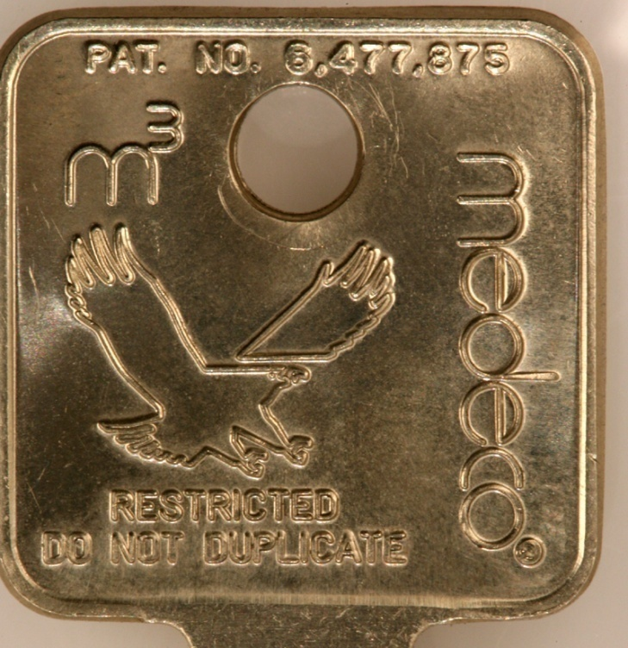
MEDECO KEY CONTROL: Virtually Impossible to Copy
[medeco quote from adv]

Slide 25
MEDECO KEY CONTROL:
The Problem
CIRCUMVENTING SECURITY LAYERS
  KEYWAYS CAN BE BYPASSED
  BLANKS CAN BE SIMULATED
  SIDEBAR CODES ARE SIMULATED
  SLIDER CAN BE BYPASSED
NO REAL LEGAL PROTECTION EXCEPT FOR M3 STEP

Slide 26
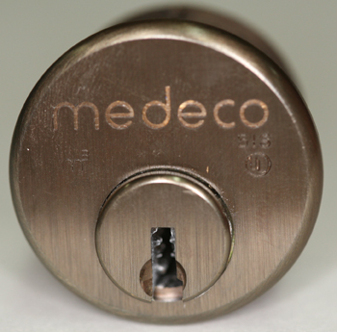
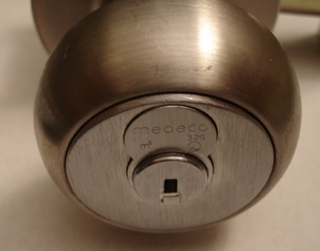
MORTISE, RIM, IC:
A Special Form of Attack
HYBRID ATTACK
Will damage the lock
Entry in ten seconds
Millions of Locks affected

Slide 27
“KEYMAIL”: The New Security Threat from Within
NEW AND DANGEROUS THREAT
THE NEW MULTI-FUNCTION COPIER
It scans, copies, prints, and allows the production of MEDECO keys
[medeco copier photo]

Slide 28
KEYMAIL: How It Works for Mortise, IC, and Rim Cylinders
ACCESS TO THE TARGET KEY
CAPTURE AN IMAGE
PRINT THE IMAGE
PRODUCE A KEY
OPEN THE LOCK

Slide 29
PLASTIC KEYS: PROCEDURE
OBTAIN IMAGE OF THE KEY
  Scan, copy, or photograph a Medeco key
  Email and print the image remotely
  Print 1:1 image on paper or plastic Shrinky Dink
  Trace onto plastic or cut out the key bitting
INSERT KEY INTO PLUG
  Neutralize three layers of security
  Open Mortise, Rim, IC cylinders

Slide 30
ACCESS TO TARGET KEY
BORROW BRIEFLY
AUTHORIZED POSSESSION
USE
COLLUSION WITH EMPLOYEE WHO HAS ACCESS TO A KEY

Slide 31
CAPTURE AN IMAGE
COPIER
TRACE THE KEY
CELL PHONE CAMERA
SCANNER

Slide 32
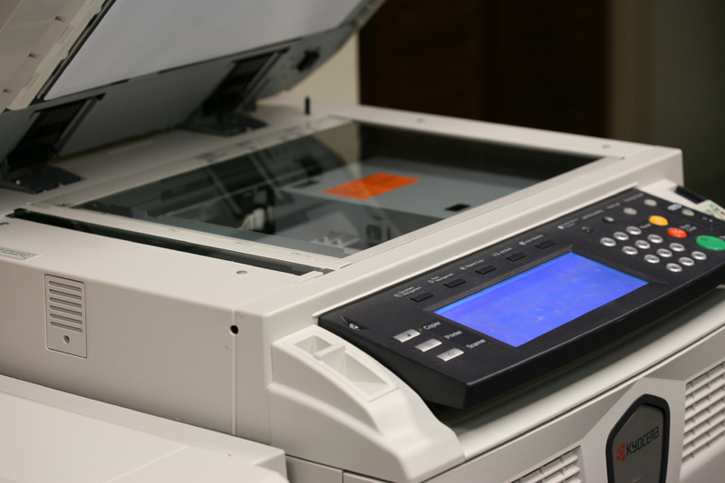
OBTAIN DATA - COPIER

Slide 33
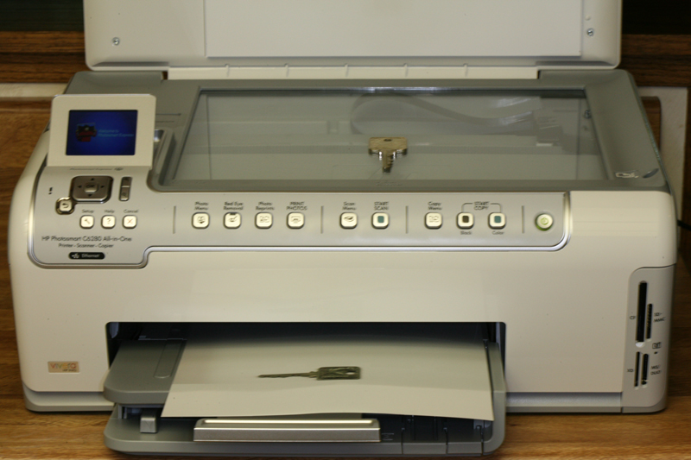
OBTAIN DATA
SCANNER

Slide 34
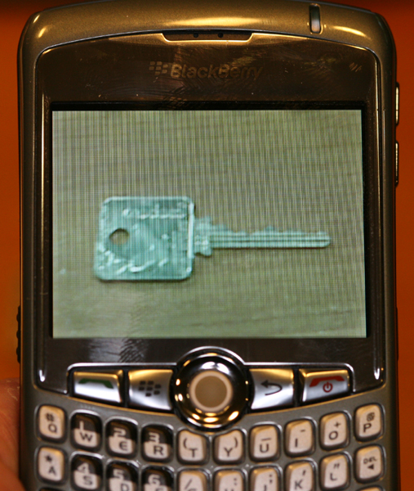
OBTAIN DATA
CELL PHONE

Slide 35
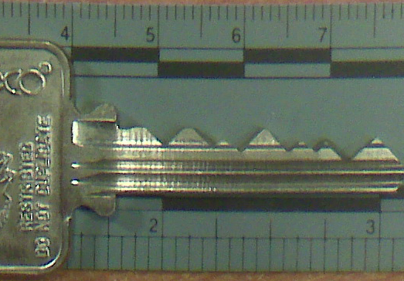
BLACKBERRY CURVE
CAPTURED IMAGE

Slide 36
RESULTING IMAGE
REPRODUCE THE IMAGE
  On Paper
  On plastic sheet
  On Adhesive Labels
  On Shrinky dinks® plastic
  On a piece of copper wire
  On a simulated metal key

Slide 37
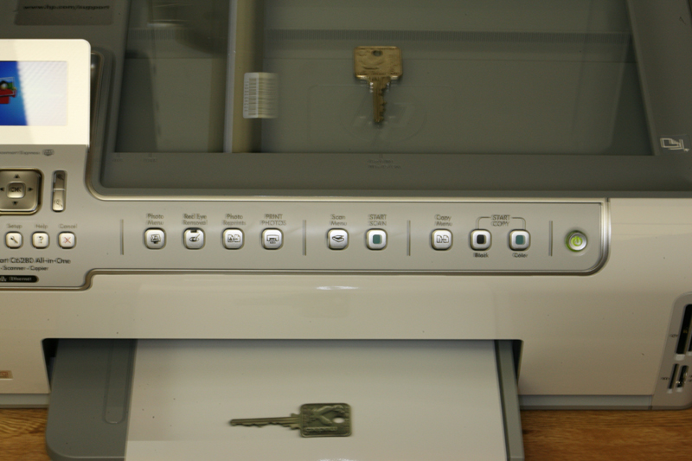
PRINT IMAGE
ON PLASTIC OR PAPER

Slide 38
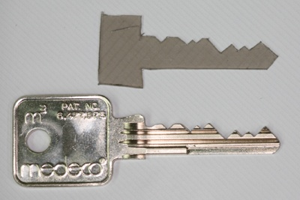
SET THE SHEAR LINE
PLASTIC KEY SETS SHEAR LINE

Slide 39
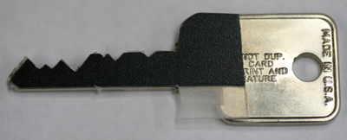

SET THE SHEAR LINE

Slide 40
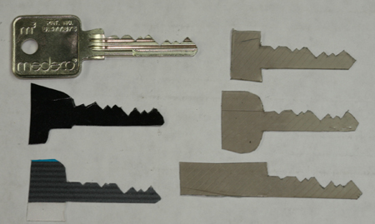
SET THE SHEAR LINE

Slide 41
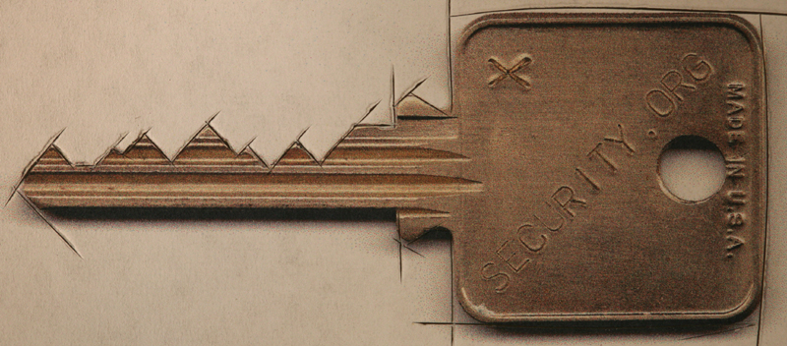
CUT A FACSIMILE OF KEY
KEY REQUIREMENTS
  Vertical bitting only
  No sidebar data
  No slider data

Slide 42
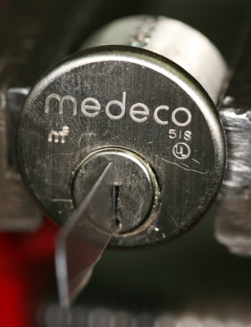
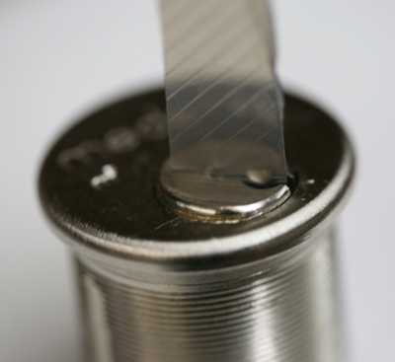
SET THE SHEAR LINE:
OPEN THE LOCK

Slide 43
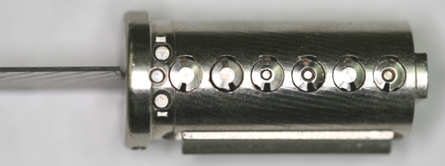
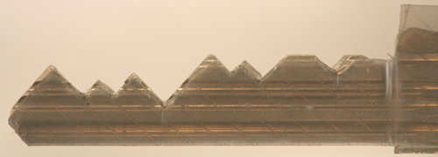
NEUTRALIZE SHEAR LINE

Slide 44
LOCKS, LIES, AND VIDEOTAPE: MEDECO CASE STUDY
MEDECO CASE STUDY
  Medeco security: “Our locks are bump-proof, virtually bump-proof, and Virtually Resistant”
  We Never claimed our Locks were bump-proof!
  Our deadbolts are secure, no problem!
  We have spent hundreds of hours and cannot replicate any of the Tobias attacks!

Slide 45
MEDECO RECOGNIZES LOCKSPORT: NDE: May, 2008
BASED ON RESPONSIBLE DISCLOSURE ABOUT MEDECODER
  Give Medeco time to fix the vulnerability
  Right result, wrong reason
  No t new: 15 year old bypass
  Problem in millions of locks
  Concept not applicable

Slide 46
KNOWN VULNERABILITIES IN MEDECO LOCKS
RESPONSIBLE DISCLOSURE v. IRRESPONSIBLE NON-DISCLOSURE
  Serious vulnerabilities disclosed
  Notice to manufacturer for 18 months
  Failure to disclose to dealers or customers
  Misrepresentation, half truth, misleading advertising and use of language that means nothing

Slide 47
RESPONSIBLE DISCLOSURE: It is a Two-Way Street
DISCOVERY OF VULNERABILITY
  Locksport, hacker, security expert disclosure to manufacturers
  Manufacturers to dealers and consumers
SIGNIFICANT QUESTIONS
  When discovered
  New lock or embedded base
  Number of users affected
  National security issues

Slide 48
RESPONSIBILITIES
Locksport and hacker responsibility
  Disclose vulnerability in new lock design or upgrade
  What about current locks that are installed
  Give time to fix? When relevant?

Slide 49
HIGH SECURITY LOCK MANUFACTURERS
Responsibility of high security lock manufacturer are different
  High security is different than normal mfg or corporation
  Protect high value targets, critical infrastructure
Duties
  Tell the truth
  Disclose security vulnerabilities to customers and dealers

Slide 50
RESPONSIBLE DISCLOSURE: REALITY, AND LIABILITY
WHAT TO DISCLOSE AND TO WHOM
TWO COMPONENTS
PUBLIC RIGHT AND NEED TO KNOW
  SECURITY BY OBSCURITY
  ASSUME THE RISK, ONLY CAN BE BASED UPON KNOWLEDGE
  BAD GUYS KNOW
LOCKS NOT LIKE SOFTWARE
  NOTICE ONLY PROSPECTIVE TO FIX PROBLEMS

Slide 51
DISCLOSURE TO MANUFACTURER: Prospective or Retroactive Effect
PROSPECTIVE IMPLEMENTATION OF FIX BY MANUFACTURER
  Only applies to new locks or new product
  Does not apply to embedded base
  Does not help the consumer unless manufacturer does a recall or field fix
QUESTION OF LIABILITY AND COST
  Who will pay for retroactive upgrade?
  “Enhancement” to new bypass technique or liability to remedy?

Slide 52
MEDECO TIMELINE
1994 ARX pins and John Falle decoder
2006 Bumping of conventional locks
  Medeco issues press release: Bump-Proof
2006-2007 Data to Medeco regarding bumping, picking, and key control
2007 Tobias Deadbolt attack
2007 JennaLynn Bumps a Biaxial
2008 Jon King Medecoder and Medeco recognition of Locksport community

Slide 53
MEDECO: Responsible or Irresponsible Actions?
BUMPING CLAIMS BY MEDECO
August 4, 2006 Press Release: “Our Locks are Bump-Proof!”
2007: Retroactive change, “Our Locks are Virtually Bump-Proof”
2007: “Our locks are virtually resistant!”

Slide 54
MEDECO BUMPING CLAIM:
“We never said it: Others did!”
WHAT IS THE TRUTH?
  August 4, 2006 press release: “Bump-proof”
  2007 - Retroactively changed the language: “Virtually Bump-proof”
  The Medeco Problem: www.archive.org
TV, Advertising, DVD, Medeco website
The Smoking Gun: August 12, 2006

Slide 55
WE NEVER SAID OUR LOCKS WERE BUMP-PROOF
AUGUST 15, 2006
U.S. Patent and Trademark Office filing by Medeco Security Locks, Inc. lawyer G. Franklin Rothwell, Application 78952460
Word mark: BUMP PROOF
Abandoned: February 9,2007

Slide 56
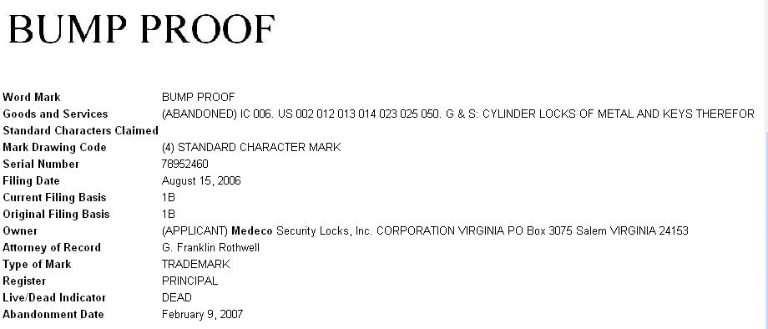
BUMP PROOF: USPTO FILING FOR THE WORD MARK

Slide 57
ABOUT CLAIMS OF PICKING
MEDECO LOCKS
NOBODY HAS PROVED THEY CAN PICK OUR LOCKS IN 40 YEARS
  False demonstrations, special locks
  They are lying
  We cannot replicate anything
THE REAL PROBLEM
  They cannot open their own locks
  Failure of imagination

Slide 58
RESPONSIBLE DISCLOSURE BY LOCK MANUFACTURERS
KNOWLEDGE OF VULNERABILITY
Known or suspected
Make responsible notifications
Let users and dealers assess risks
Duty to tell the truth
Duty to fix the problem

Slide 59
MEDECO LOCKS ARE VULNERABLE
MEDECO KNOWS
Vulnerability from Bumping, Picking, Key control, Forced Entry techniques
Should be candid with dealers and users so they understand the potential risks
Failure to tell the truth = irresponsible non-disclosure
Dealers and customers have a need and a right to know

Slide 60
VULNERABILITIES:
Full Disclosure Required
SECURITY BY OBSCURITY
It does not work with Internet
It is the User’s security
They have a right to assess their own risks
Criminals already have information
Disclosure: benefits outweigh risks
Liability for failure to disclose

Slide 61
LESSONS LEARNED
THE MEDECO CASE
Nothing is impossible
Corporate arrogance does not work
HIGH SECURITY LOCK MAKERS
Engineering, Security, Integrity
Duty to tell the truth

Slide 62
OPEN IN THIRTY SECONDS
© 2008 Marc Weber Tobias, Matt Fiddler
http://www.security.org
http://in.security.org
mwtobias@security.org
mjfiddler@security.org
tbluzmanis@security.org

