Slide 1
HIGH SECURITY LOCKS: MYTHS AND REALITY
Insecurity Engineering Issues in the design of locks
ELF 2011 Tel Aviv

Slide 2
RELEVANT CONSIDERATIONS
STANDARDS
PATENTS
WHAT IS SECURITY?
ATTACK TECHNOLOGIES AND TOOLS
APPEARANCE OF SECURITY V. REALITY
DESIGN FLAWS OR EXPLOITS
EXAMPLES OF INSECURITY ENGINEERING

Slide 3
INSECURITY ENGINEERING
OUR ANALYSIS OF SECURITY
  LOCKS
  INTERACTIVE MECHANISMS
  BOLTS AND LATCHES
  LOCK CASE
  ASSOCIATED HARDWARE
  ELECTRONICS INTEGRATION
  COMPONENT FAILURE ANALYSIS

Slide 4
INSECURITY ENGINEERING
DEFICIENT, DEFECTIVE OR DESIGN LIMITATIONS
  Intersection of mechanical and security engineering
FALSE SENSE OF SECURITY
  What appears secure is not
  How do you know the difference?
  Undue reliance on standards
MISREPRESENTATIONS BY MFG
  Knowing or unknowing
  Misrepresentations by others

Slide 5
ENGINEERING FAILURES: RESULTS AND CONSEQUENCES
INSECURITY ENGINEERING
  Insecure products
  Often easily bypassed
  Use standards as the measure when they do not address the relevant issues
  Products look great but not secure
  False sense of security

Slide 6
EXAMPLES PRESENTED TODAY
NOT HERE TO ATTACK ANY SPECIFIC MANUFACTURER
EXAMINE SECURITY ENGINEERING ISSUES
WHAT APPEARS SECURE IS NOT
THE ANALYSIS PROCESS
WE NEVER RELY ON WHAT MANUFACTURERS TELL US ABOUT THEIR SECURITY

Slide 7
LOCK DEVELOPMENT: AN EVOLVING PROCESS
200+ YEAR CONTEST BETWEEN MANUFACTURERS, LOCKSMITHS, CRIMINALS
JOHN HOBBS: LONDON 1851 AND THE BRAMAH LOCK
SECURE TODAY, OPENED TOMORROW
TOOL COMPANIES IN BUSINESS BECAUSE OF INSECURE LOCK DESIGNS

Slide 8
IS THE LOCK SECURE?
COMPLEX QUESTION
  Against what?
  Prior intelligence
  Value of target and location?
  Other security layers
  Against whom?
  For how long?
  Where?
  User expectations of security?
  Price

Slide 9
COST AND APPEARANCE v. QUALITY AND SECURITY
DO YOU GET WHAT YOU PAY FOR?
2$ LOCKS ARE 2$ LOCKS!
SHORTCUTS DO NOT EQUAL SECURITY
CLEVER DESIGNS MAY REDUCE SECURITY
PATENTS DO NOT GUARANTEE SECURITY

Slide 10
PRIMARY RULES
THE KEY NEVER UNLOCKS THE LOCK
ALL LOCKS ARE MECHANICAL
JUST BECAUSE IT IS PATENTED DOES NOT MEAN IT IS SECURE
DO NOT RELY ON STANDARDS
EVERY LOCK CAN ULTIMATELY BE COMPROMISED; REMEMBER THE 3T2R RULE!

Slide 11
THE KEY NEVER UNLOCKS THE LOCK: EXAMPLES
MEDECO DEADBOLT
SCORPION DEADBOLT
IKON CLIQ ATTACKS: RAPPING, VIBRATION AND OTHERS
KABA SIMPLEX AND IN-SYNC WIRE
MUL-T-LOCK CLIQ VIBRATION
BIOLOCK FINGERPRINT
RB LOCK, OVER LIFTING
DIFFERENT SIDEBAR CODES: RB
DRIVER PINS BELOW SHEAR LINE

Slide 12
VULNERABILITIES: REAL OR THEORETICAL
MECHANICAL LOCKS
ELECTRO-MECHANICAL LOCKS
ELECTRONIC LOCKS
LAYER ATTACK DEVELOPED FOR MEDECO
COMPROMISE OF KEY SECURITY

Slide 13
STANDARDS
HIGH SECURITY LOCKS
  FORCED ENTRY: 5 MINUTES
  COVERT ENTRY: 10 OR 15 MINUTES
  KEY CONTROL
WHAT DO THEY MEAN
WHAT DO THEY LEAVE OUT
WHY THEY MAY NOT PROTECT YOU

Slide 14
KEY CONTROL v.
KEY SECURITY
WHAT CONSTITUTES KEY SECURITY?
LAYERED ATTACK: BITTING + SIDEBAR CODES
SIMULATE, REPLICATE, DUPLICATE
HAVE SIDEBAR CODES, IMPRESSION THE LOCK
SAME SIDEBAR CODES

Slide 15
COVERT ENTRY STANDARDS
WHAT DO THEY TYPICALLY COVER
  PICKING
  MANIPULATION?
WHAT DO THEY NOT COVER
  MECHANICAL BYPASS
  BUMPING
  DECODING TOOLS
  MAGNETICS
  OTHER FORMS OF ATTACK

Slide 16
FORCED ENTRY ATTACKS
RIGID RULES AND TESTS
DO NOT CONTEMPLATE HYBRID ATTACKS
DO NOT ADDRESS OTHER SIMPLE ATTACKS
  MEDECO DEADBOLT AND MORTISE
  SCORPION DEADBOLT

Slide 17
BYPASS 101: THE BASICS IN SECURITY ENGINEERING
COMB ATTACK AND PIN OVERLIFTING v. BALANCED DRIVERS
MAGNETICS
ACCESS TO CRITICAL COMPONENTS
VIBRATION AND SPRINGS
SHOCK, BUMPING, AND VIBRATION
WIRES AND SHIMS
MECHANICAL BYPASS

Slide 18
EXPERTISE REQUIRED IN LOCK DESIGN
MECHANICAL ENGINEERING
SECURITY ENGINEERING
MINIMUM INDUSTRY STANDARDS REQUIRE LEVEL OF KNOWLEDGE
SECURITY ENGINEERING REQUIRES:
  UNDERSTAND USE OF WIRES, MAGNETS, PAPERCLIPS, BALL POINT PENS, ALUMINUM FOIL…..
  BYPASS TECHNIQUES

Slide 19
MANUFACTURER LIABILITY
ALL SECURITY IS ABOUT LIABILITY
COULD MANUFACTURER HAVE FORSEEN THE EXPLOIT OR THREAT?
REASONABLE INDUSTRY PRACTICE AND SECURITY KNOWLEDGE
STATE-OF-THE-ART DESIGN AND CLEVER ATTACK v. STUPID DESIGN AND SIMPLE ATTACK

Slide 20
PRACTITIONER LIABILITY
FALSE OR MISLEADING STATEMENTS REGARDING SECURITY
FALSE OR MISLEADING VIDEOS
LOCKSMITH LIABILITY FOR INNACURATE STATEMENTS ABOUT WHAT THEY SELL
LOCKSMITHS ARE SECURITY EXPERTS, NOT TOASTER SALESMEN
CONTINUING SECURITY EDUCATION

Slide 21
LOCK DESIGN: EXAMPLES
MECHANICAL v. SECURITY ENGINEERING
PRIOR PRESENTATIONS
Vulnerabilities in mechanical and electro-mechanical locks
Resulted from Defective or Deficient engineering
All-encompassing standards problem
Failure to understand “why” locks can be opened, rather than “how”

Slide 22
SPECIFIC DESIGN FAILURES:
SIMPLE TO COMPLEX
KABA SIMPLEX
KABA IN-SYNC
AMSEC ELECTRONIC SAFE ES1014
ILOQ ELECTRO-MECHANICAL LOCK
  Examine each lock for security vulnerability
  Statements from the manufacturers about their security

Slide 23
HIGHER SECURITY LOCKS
ILOQ ELECTRO-MECHANICAL
MEDECO AND SCORPION DEADBOLT
RAV BAHRIAH DIMPLE LOCK
MUL-T-LOCK MT5+
CLIQ ELECTRO-MECHANICAL
MEDECO BIAXIAL AND M3

Slide 24
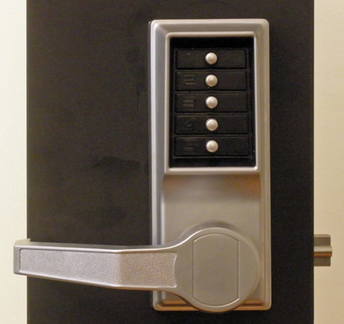
INSECURITY ENGINEERING EXAMPLE #1: KABA SIMPLEX

Slide 25
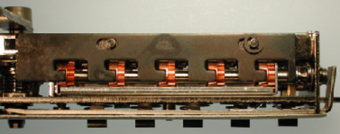
CRITICAL COMPONENT: FERROUS MATERIAL

Slide 26
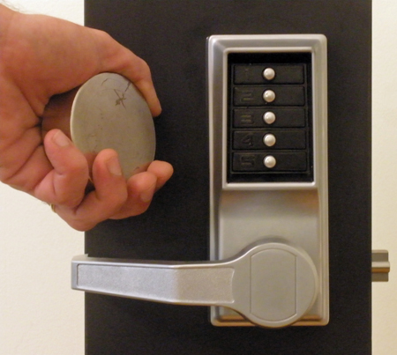
OPEN IN TWO SECONDS

Slide 27
ILOQ: ELECTROMECHANICAL CYLINDER
MADE IN FINLAND
VERY CLEVER DESIGN: PATENTS
COST: $200+
ELECTRO-MECANICAL DESIGN
MECHANICAL KEY + CREDENTIALS
NO BATTERIES: LIKE A CLOCK AND MAGNETO, GENERATES POWER
WIND-UP CLOCK-LOCK

Slide 28
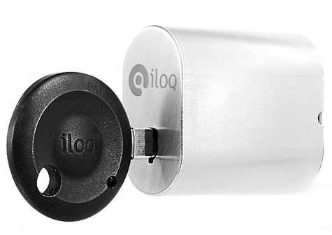
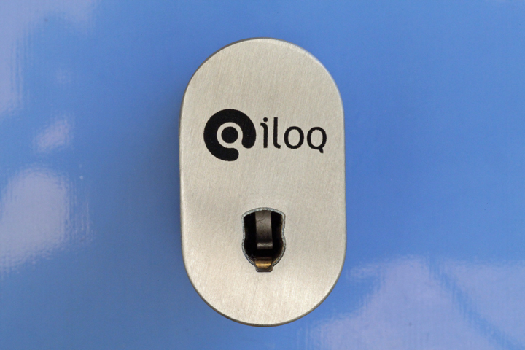
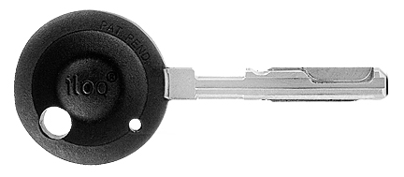
EXAMPLE #2: ILOQ:
TAKING SECURITY TO A NEW LEVEL

Slide 29
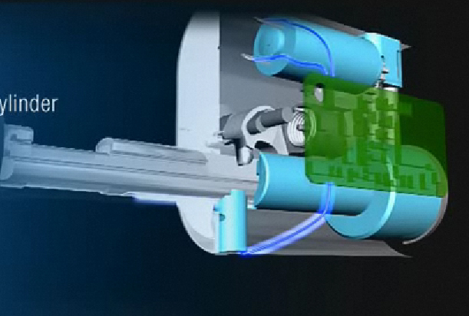
ALL KEYS IDENTICAL

Slide 30
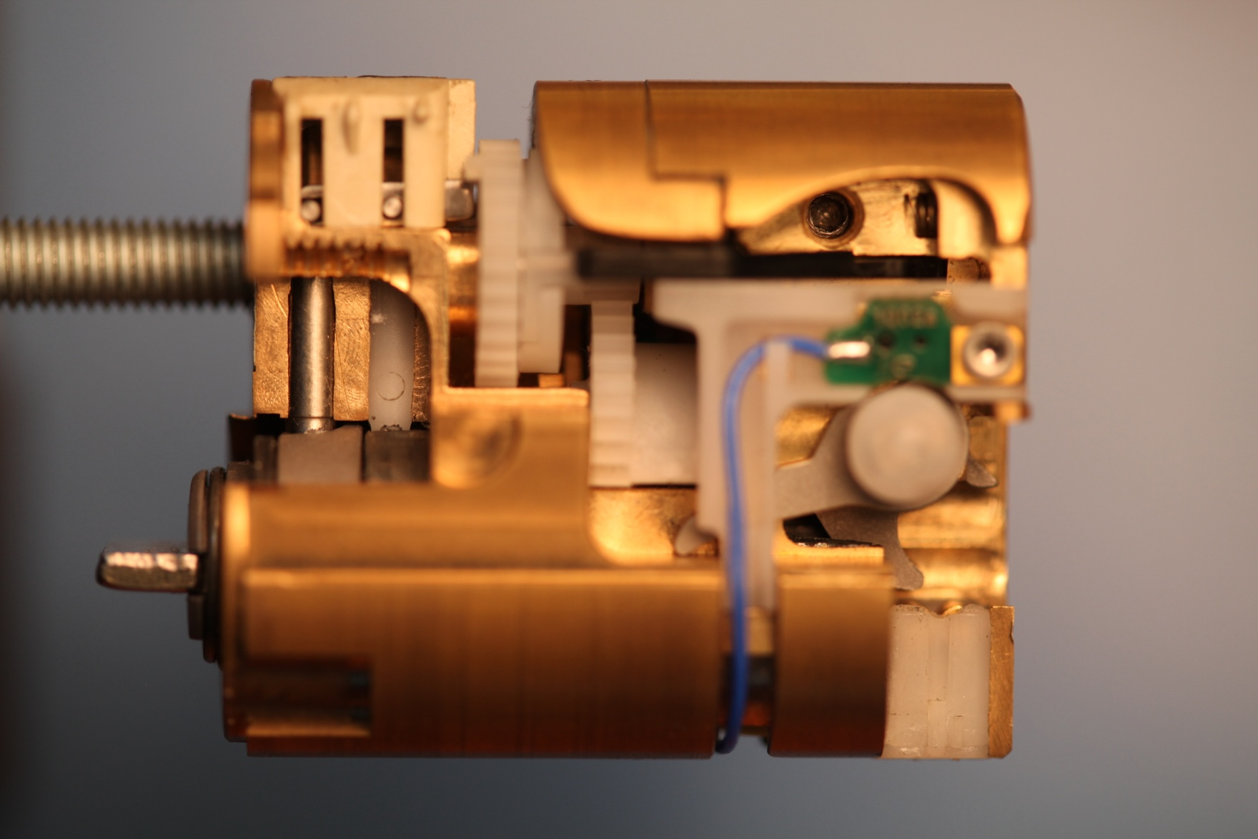
ILOQ: INSECURITY ENGINEERING

Slide 31
ILOQ VULNERABILITIES
SET THE LOCK ONCE
ANY KEY WILL OPEN
NO NEED FOR CREDENTIALS
VIRTUALLY NO SECURITY
DIFFICULT TO DETECT
LOCK OPERATES NORMALLY ONCE SET

Slide 32
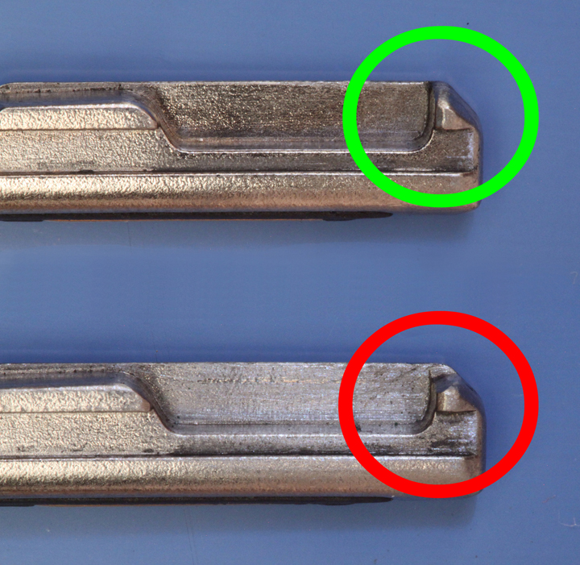
THE KEY TO ILOQ INSECURITY

Slide 33
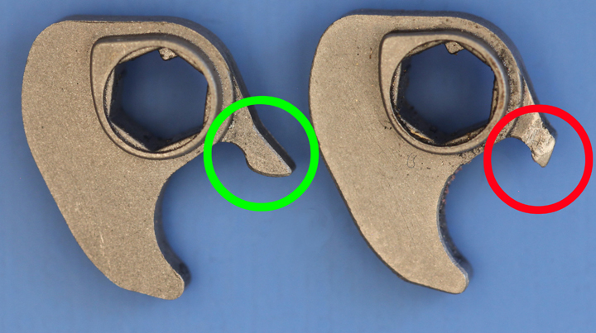
INSECURITY
ENGINEERING 101

Slide 34
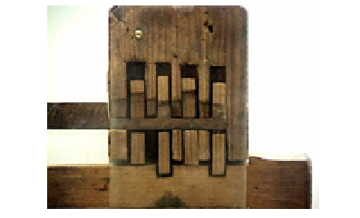
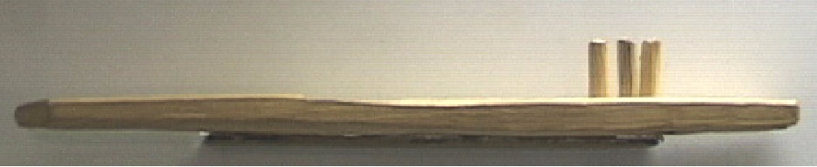
EGYPTIAN PIN TUMBLER v.
ILOQ C10S
BYPASS ELECTRONIC CREDENTIALS
  EGYPTIAN LOCK WINS

Slide 35
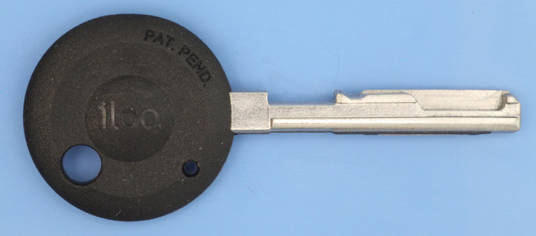
EGYPTIAN: 4000 YEARS AGO v. ILOQ KEYS

Slide 36
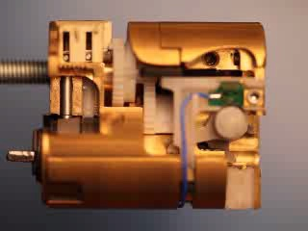
ILOQ INSECURITY

Slide 37
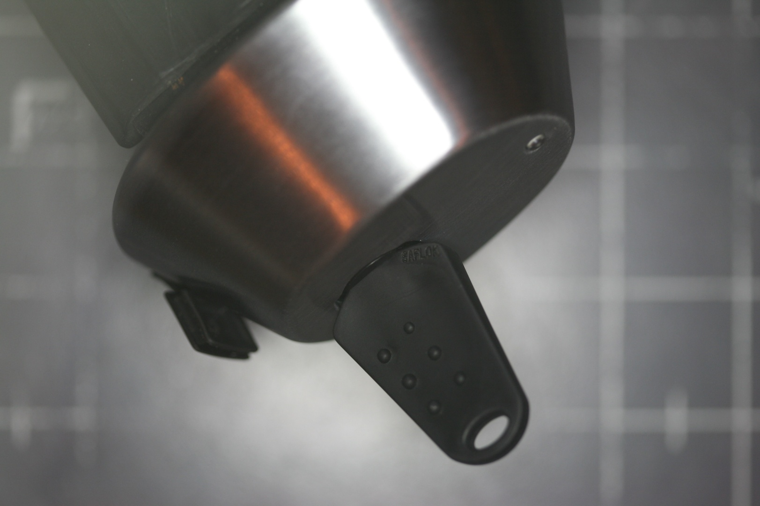
EXAMPLE #3: KABA IN-SYNC RFID-BASED LOCK

Slide 38
KABA IN-SYNC ATTRIBUTES
WIDE APPLICATOIN
AVAILABLE FOR SEVERAL YEARS
MILITARY AND CIVILIAN APPLICATIONS
USE SIMULATED PLASTIC KEY WITH RFID
AUDIT TRAIL

Slide 39
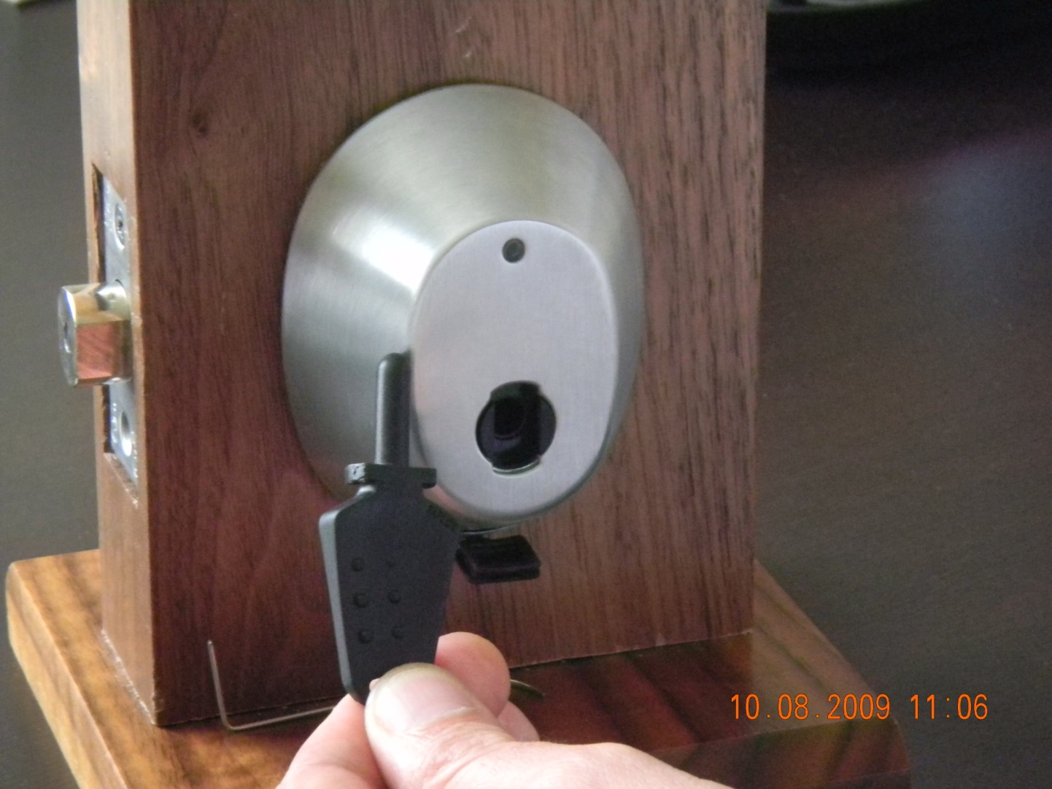
INSYNC RFID KEY LOCK

Slide 40
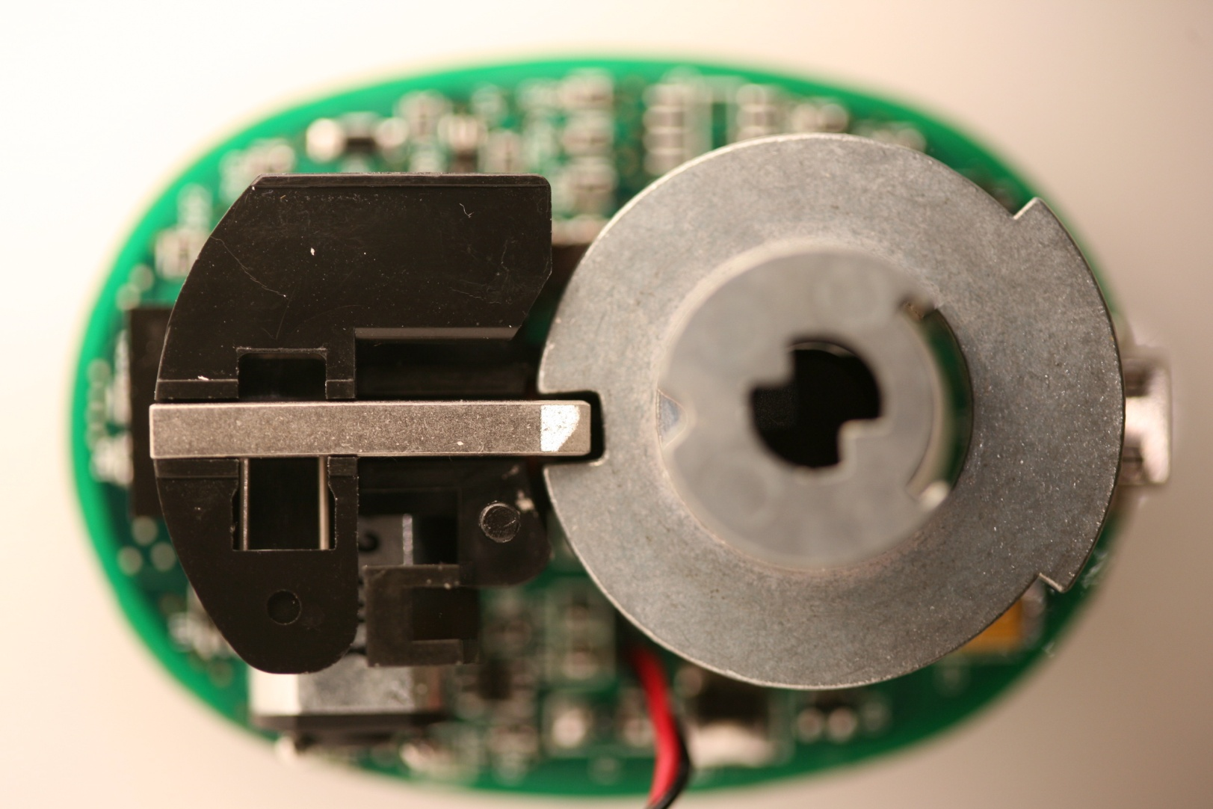
IN-SYNC INTERNAL MECHANISM: LOCKING

Slide 41
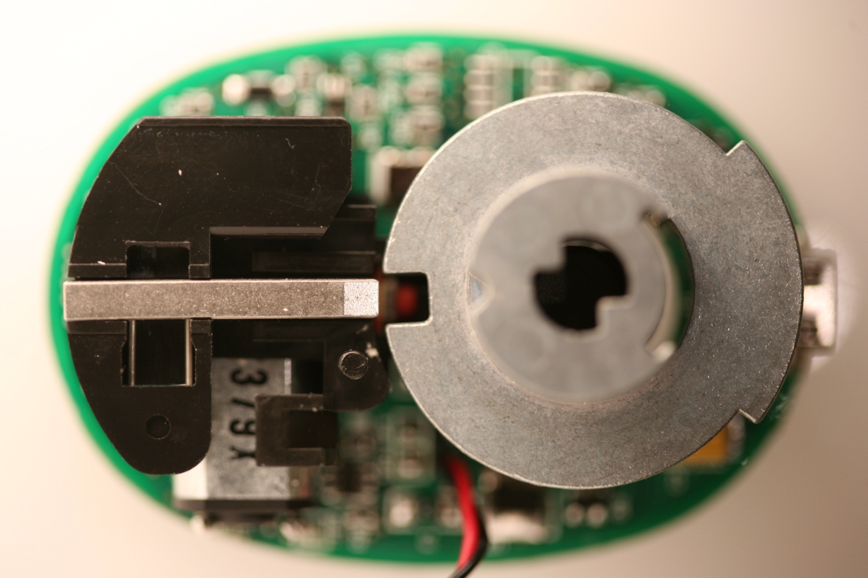
BOLT RETRACTS

Slide 42
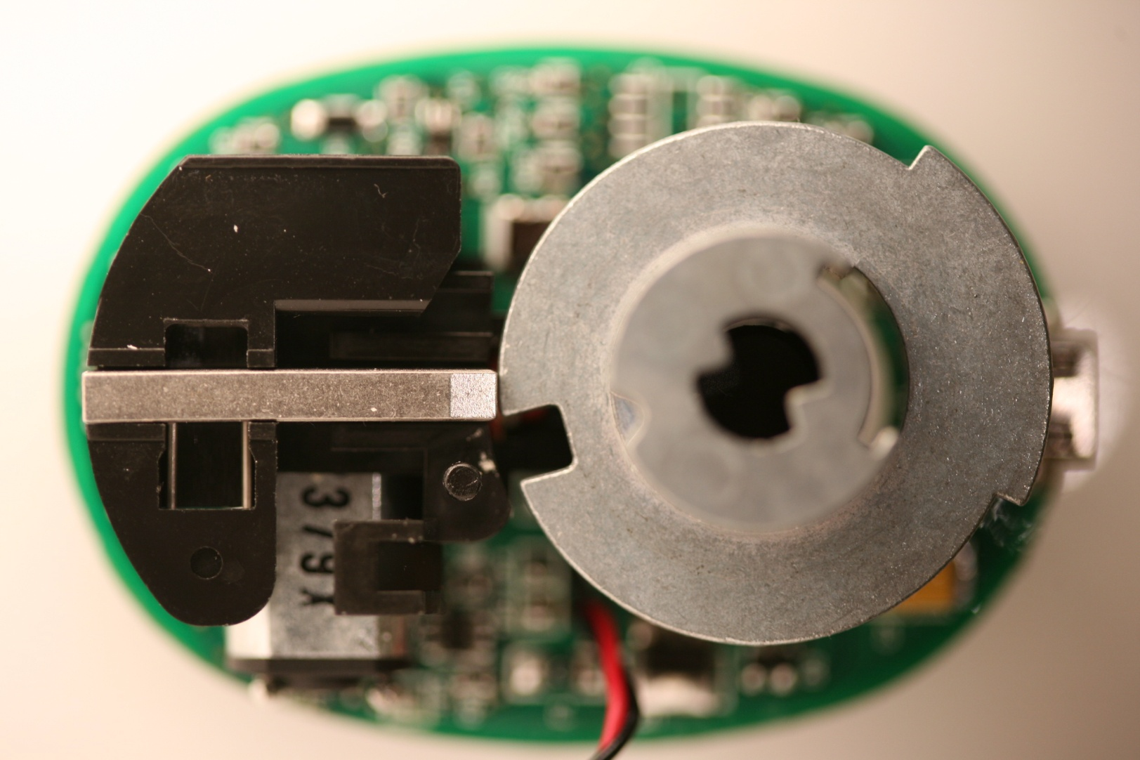
TURN TO OPEN

Slide 43
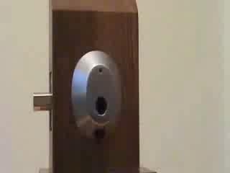
KABA INSYNC:
INSECURITY 101

Slide 44
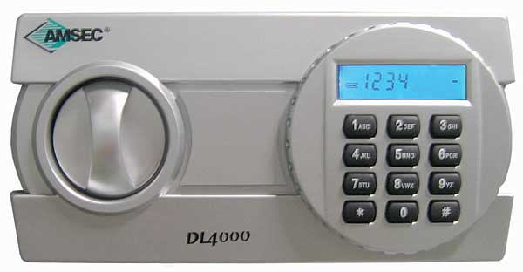
EXAMPLE #4: AMSEC ELECTRONIC KEYPAD

Slide 45
AMSEC SAFE ES1014 AND OTHERS
CONSUMER LEVEL SAFE
$100 FOR SMALLEST UNIT
ELECTRONIC KEYPAD
HOW MUCH SECURITY EXPECTED?
INCOMPETENT DESIGN
FOUND IN MANY OTHER SAFES
CHINESE IMPORT

Slide 46
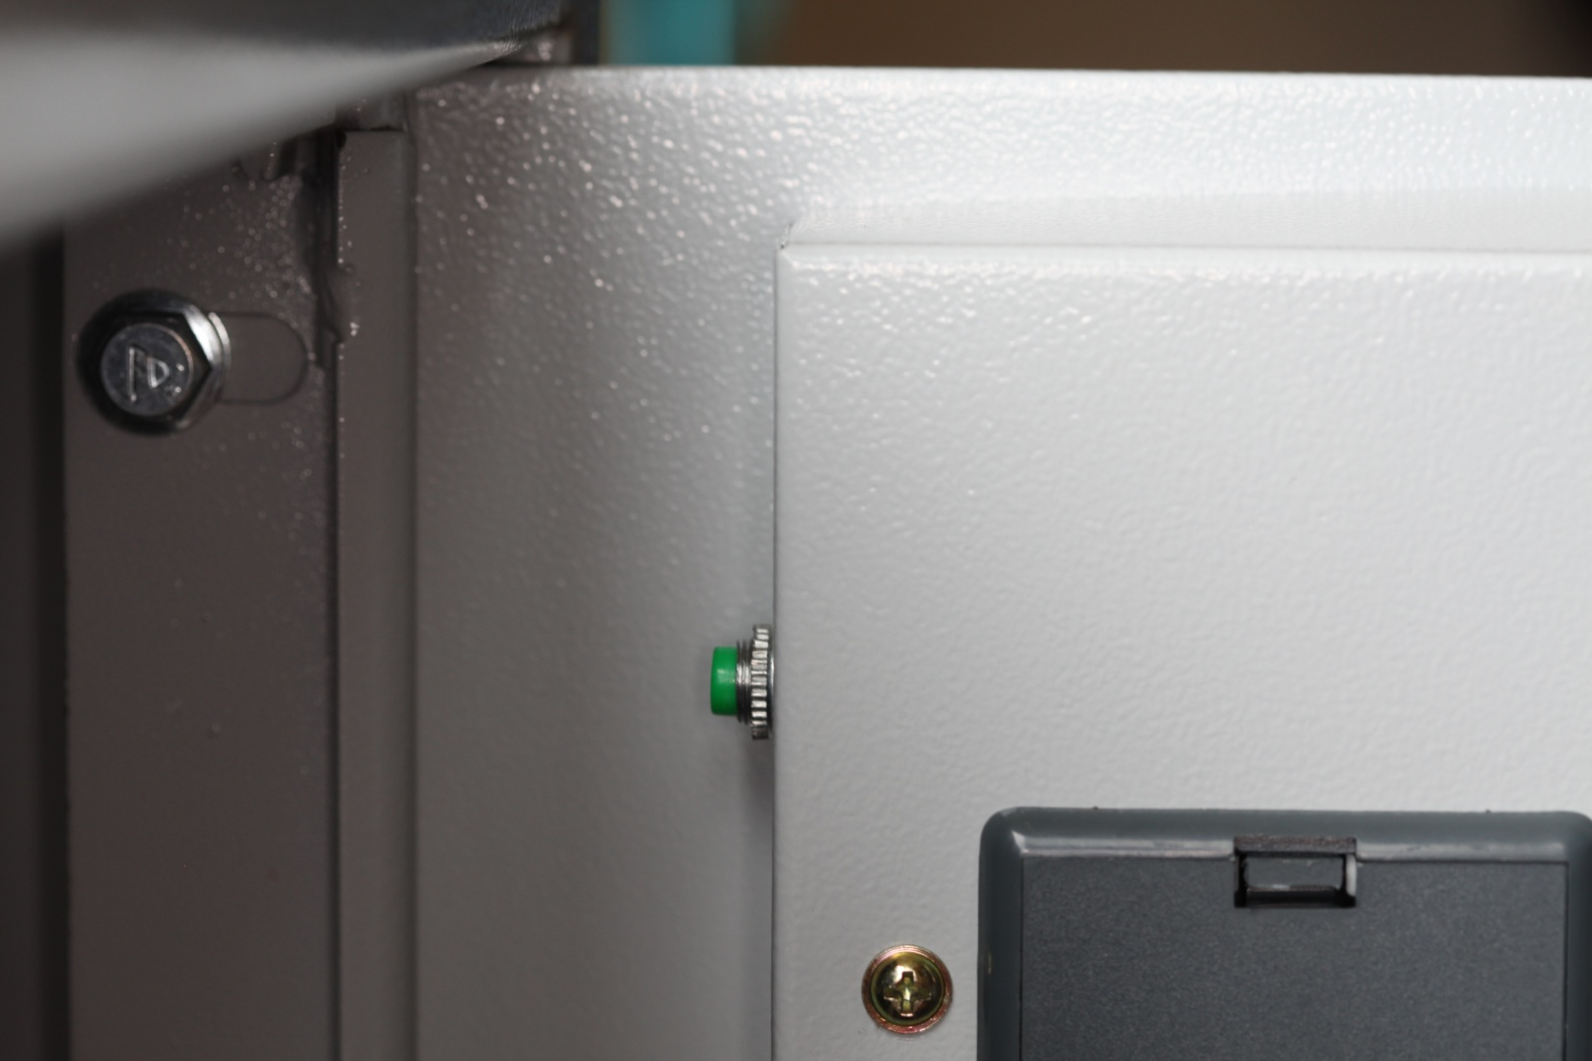
AMSEC: INSECURITY RESET

Slide 47
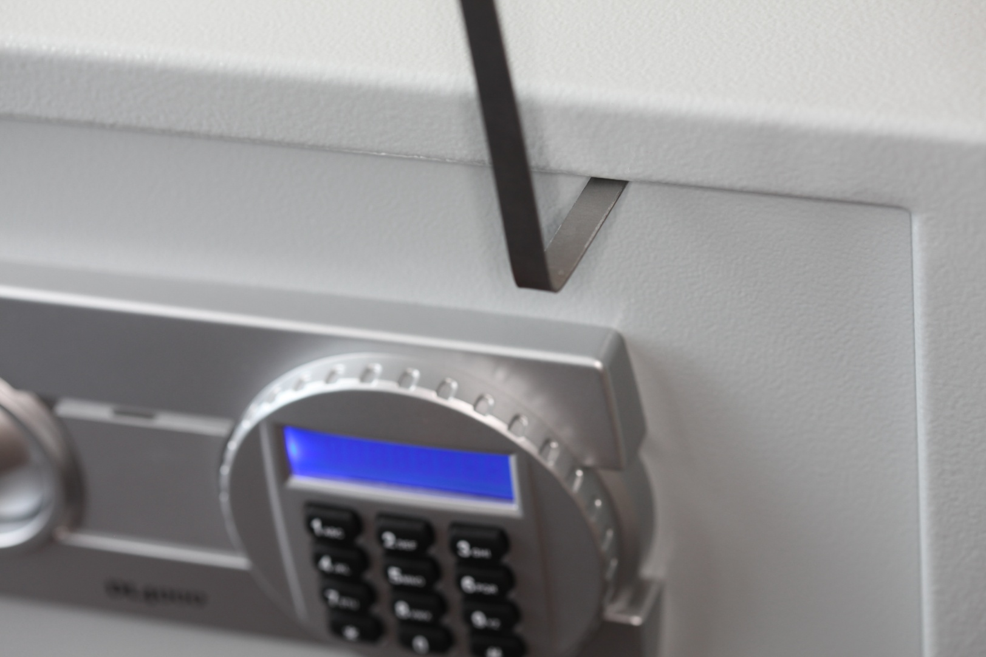
AMSEC SAFE:
INSECURITY 101

Slide 48
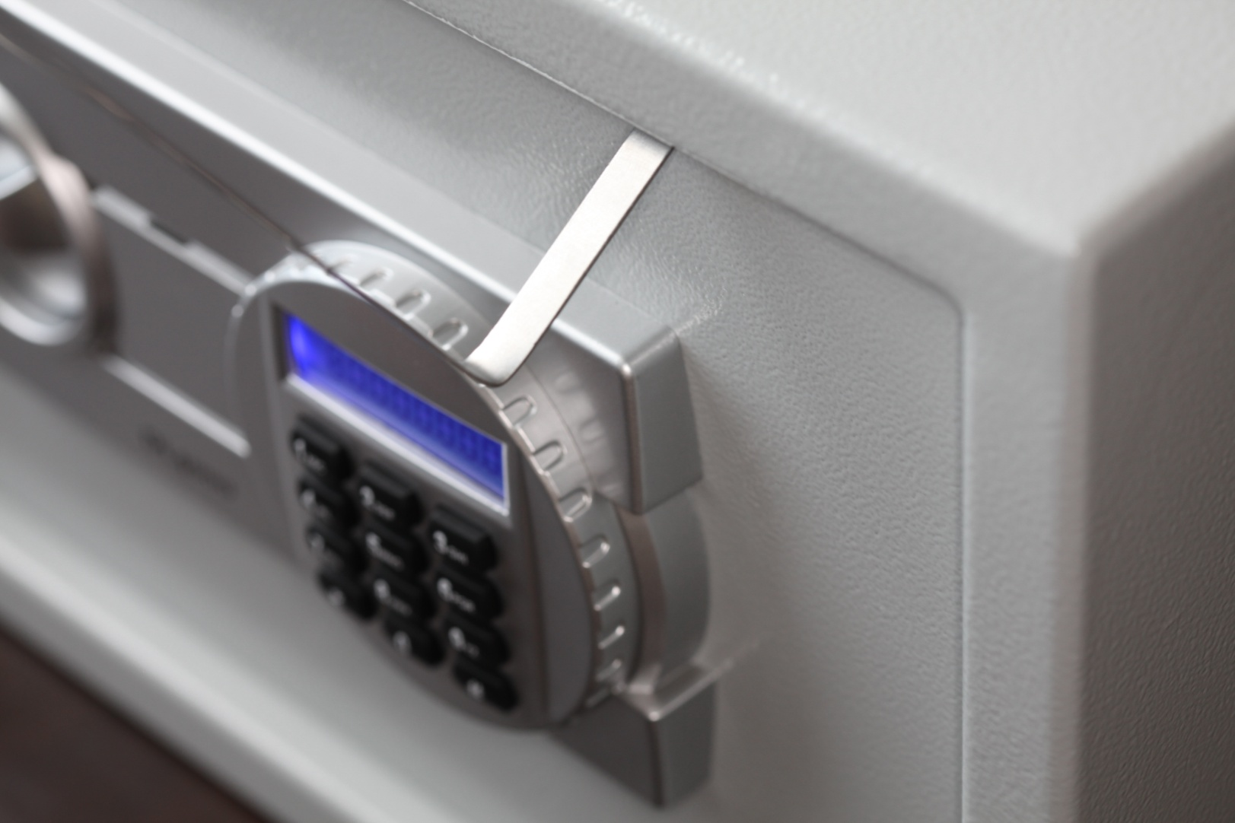
FILE FOLDER “SLIM JIM”

Slide 49
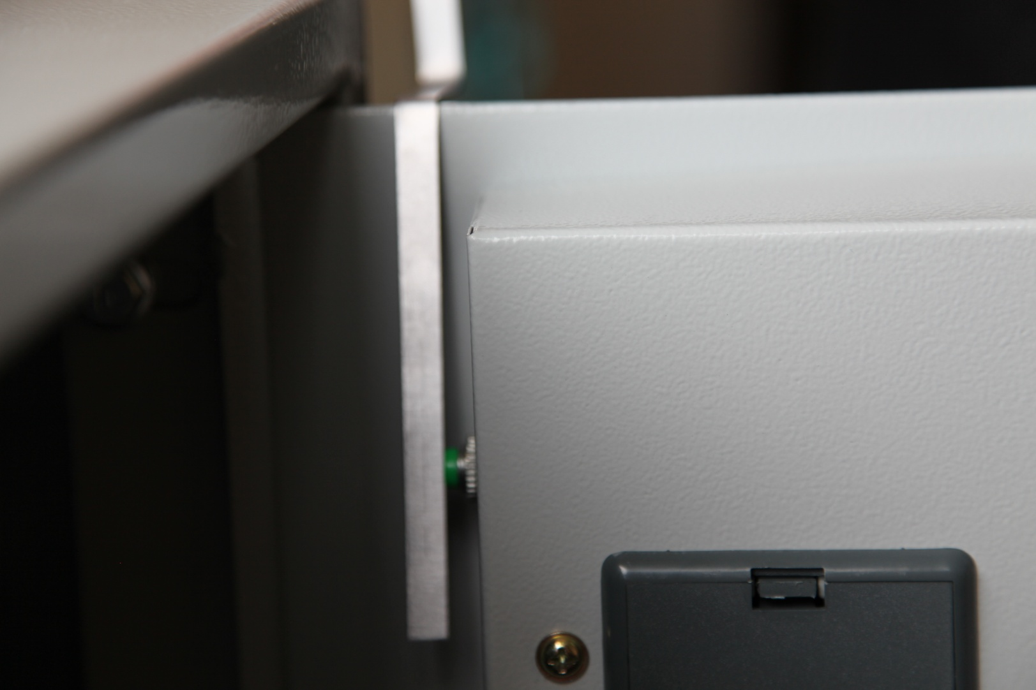
FILE THIS UNDER INCOMPETENCE

Slide 50
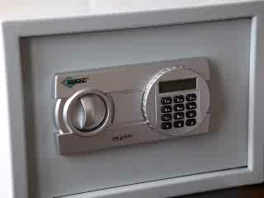
OPEN SESAME!

Slide 51
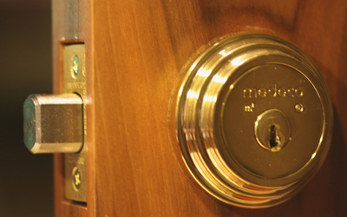

EXAMPLE #5:
DEADBOLT ATTACKS

Slide 52
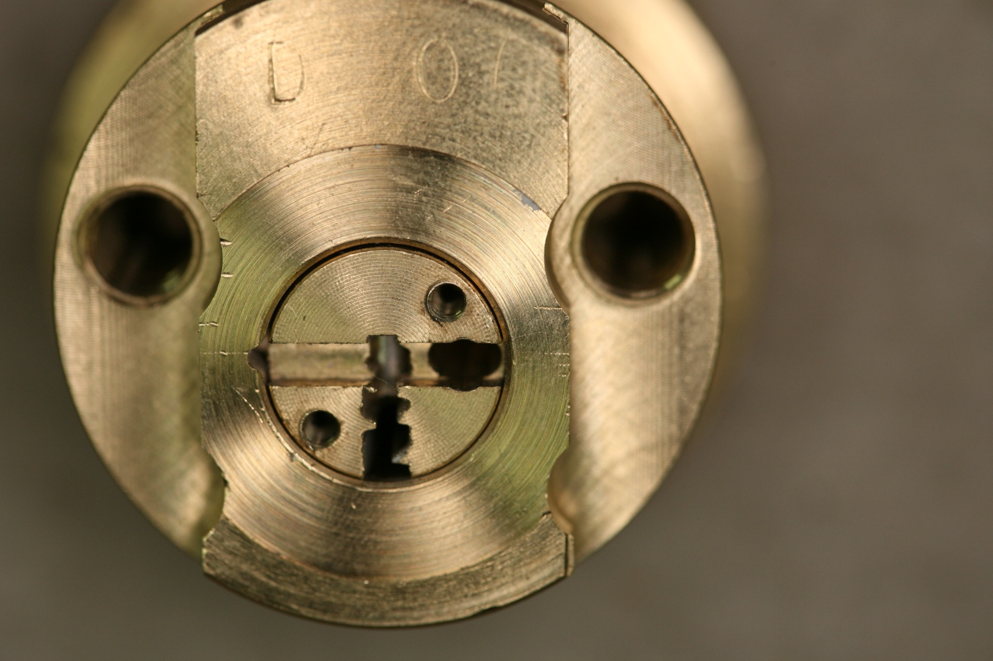
MEDECO DEADBOLT ATTACK (2007)

Slide 53
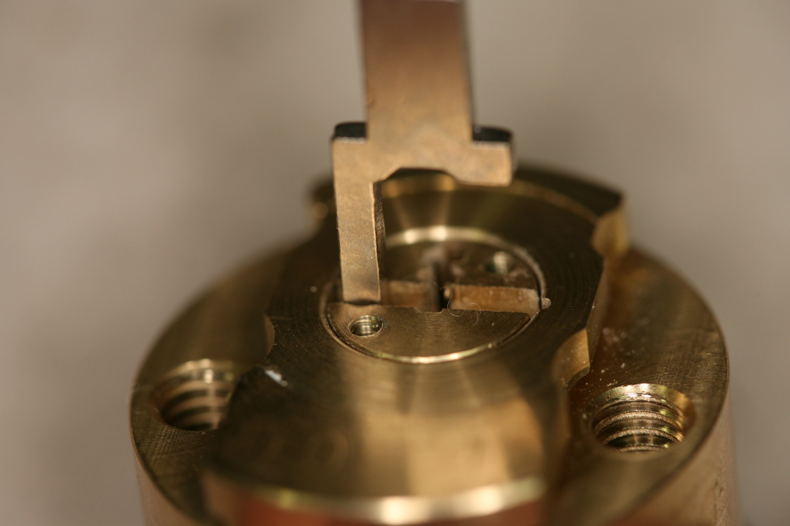
MAXUM DEADBOLT

Slide 54
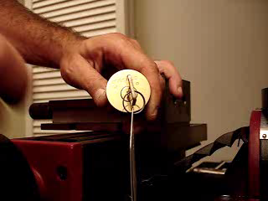
DEADBOLT DESIGNS: DEFECTIVE AND COPIES

Slide 55
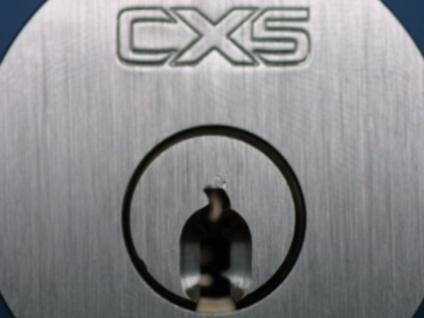
SCORPION DEADBOLT: THE MEDECO MISTAKE CLONE

Slide 56
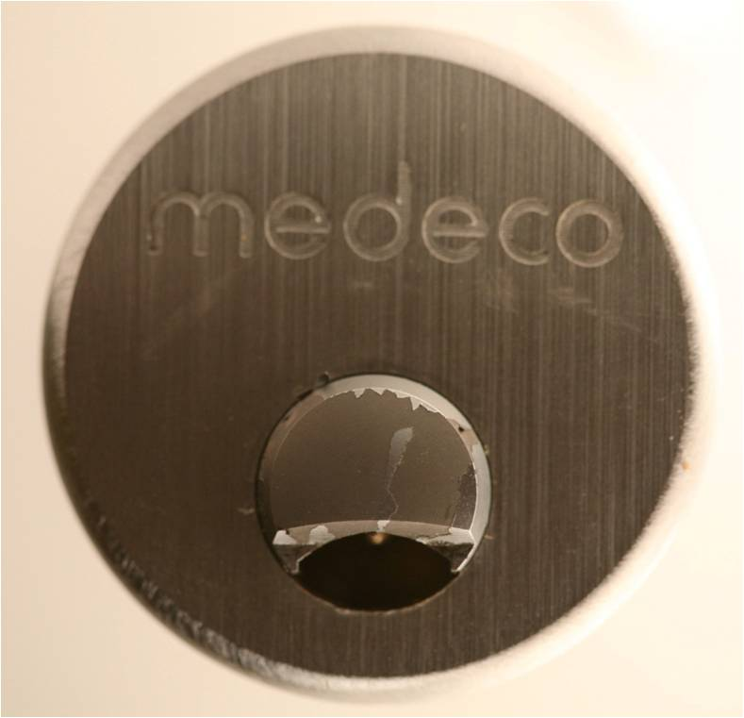
EXAMPLE #6: CLIQ PLATFORMS

Slide 57
CLIQ ATTACKS: EARLY DESIGNS
STATE OF THE ART ELECTRO-MECHANICAL LOCKS
KEY + CREDENTIALS
SIMPLE TO COMPLEX MECHANICAL BYPASS
EVOLVING DESIGN, ALL PROBLEMS ADDRESSED AND FIXED

Slide 58
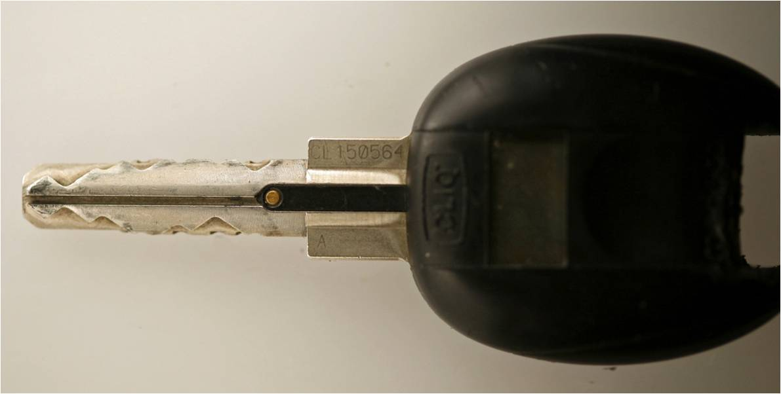
IKON CLIQ: WIRE ATTACK

Slide 59
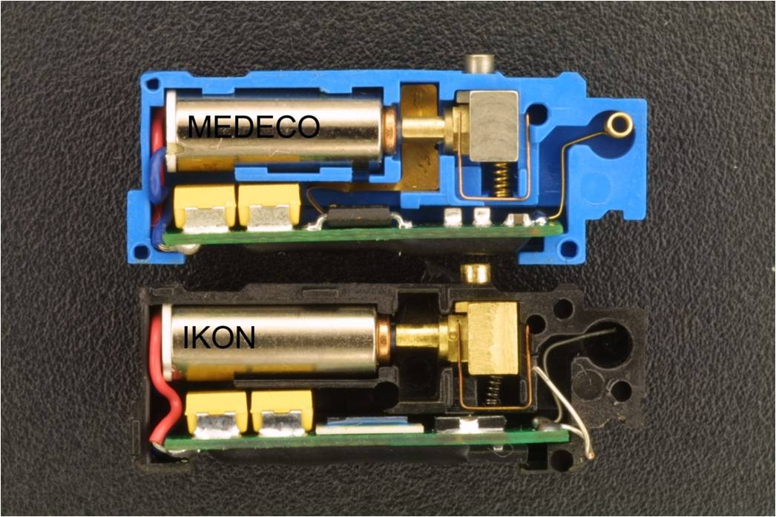
INTERNAL CLIQ

Slide 60
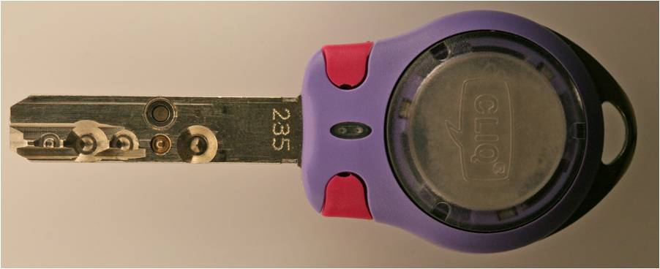
MUL-T-LOCK CLIQ

Slide 61
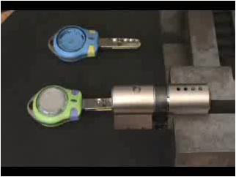
MUL-T-LOCK CLIQ: VIBRATION ATTACK

Slide 62
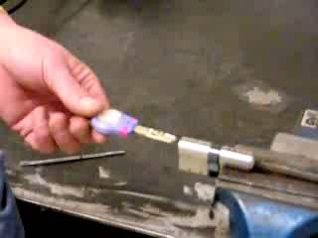
VIBRATION ATTACK

Slide 63

INVISIBLE ACCESS: EARLY CLIQ VERSIONS

Slide 64
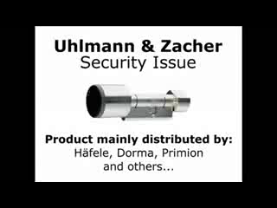
EXAMPLE #7:
MAGNETIC ATTACK

Slide 65
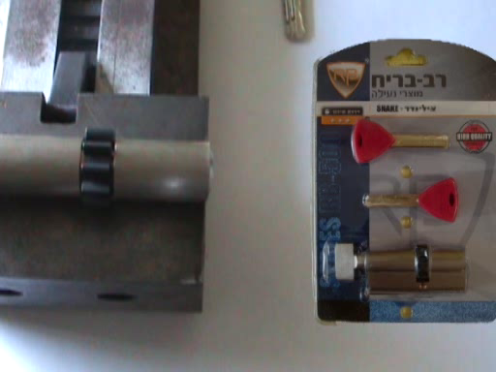
EXAMPLE #8: BYPASS BY OVERLIFTING OF PINS

Slide 66
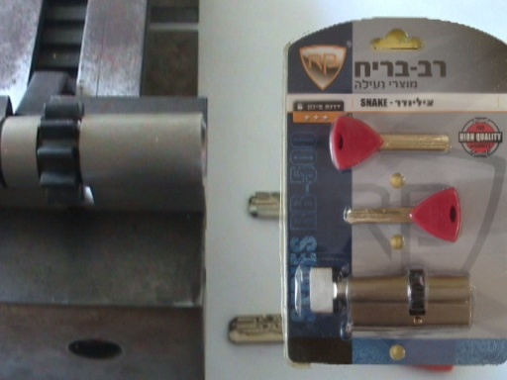
EXAMPLE #9:
RB LOCK: IMPRESSIONING

Slide 67
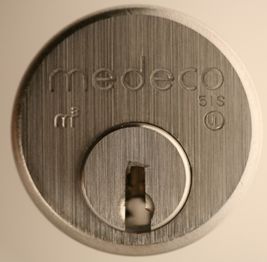
EXAMPLE #10: MEDECO HIGH SECURITY LOCKS

Slide 68
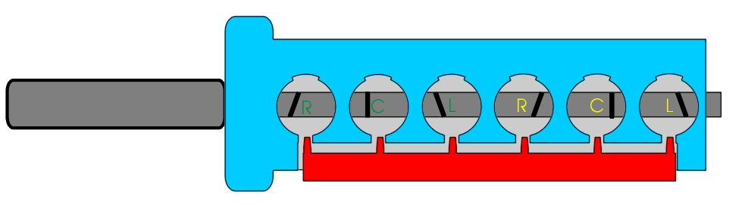
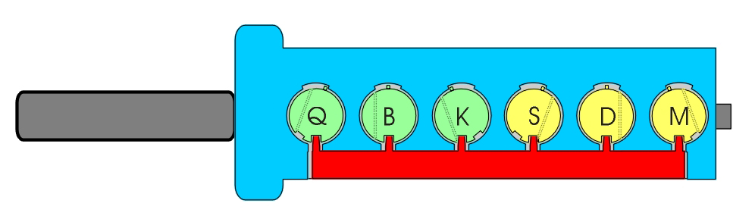
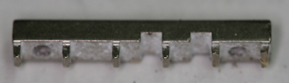
MEDECO SIDEBAR DESIGN

Slide 69
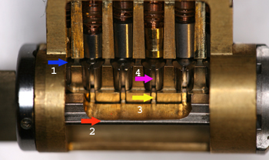
MEDECO: HOW IT WORKS

Slide 70
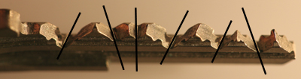
MEDECO KEY DESIGN

Slide 71
MEDECO ATTACKS
CODE SETTING KEYS
PICKING
BUMPING
REVERSE PICKING
HYBRID FORCED ENTRY: MORTISE CYLINDER

Slide 72
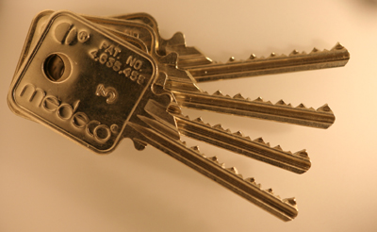
CODE SETTING KEYS

Slide 73

MEDECO ATTACKS: SET THE SIDEBAR CODE

Slide 74
REVERSE PICKING ATTACK

Slide 75
HYBRID FORCED ENTRY: MORTISE CYLINDER

Slide 76
CONCLUSIONS
MISREPRESENTATIONS BY MANY MANUFACTURERS ABOUT SECURITY
HIGH-TECH DESIGNS ≠ SECURITY
PATENTS DO NOT EQUAL SECURITY
MANY MFG DON’T KNOW OF VULNERABILITIES
INSECURITY = LIABILITY
SECURE TODAY: OPEN TOMORROW

Slide 77
HIGH SECURITY LOCKS: MYTHS AND REALITY
ELF 2011 TEL AVIV, ISRAEL
© 2011 MarcWeber Tobias, Tobias Bluzmanis
mwtobias@security.org
tbluzmanis@security.org

